Slide 1
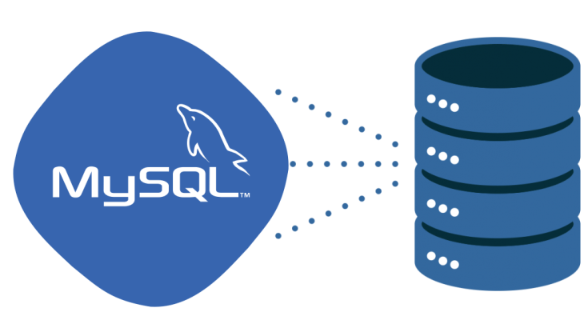
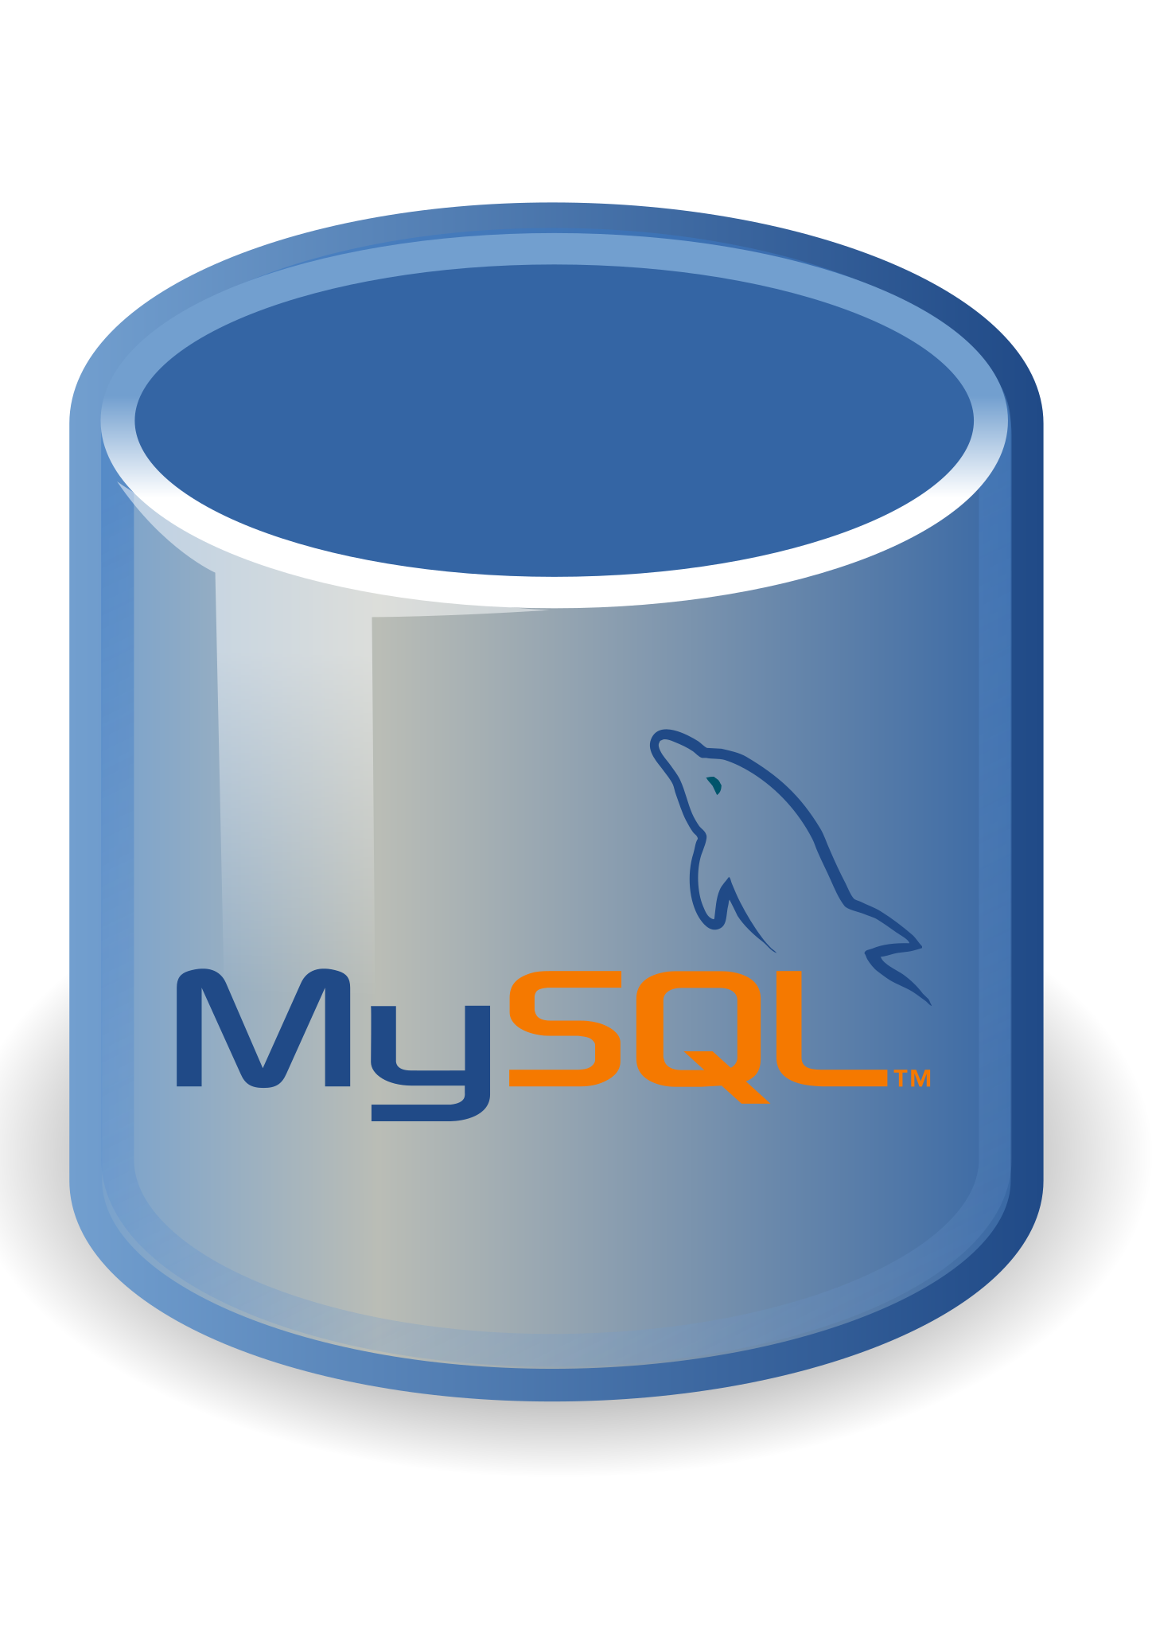
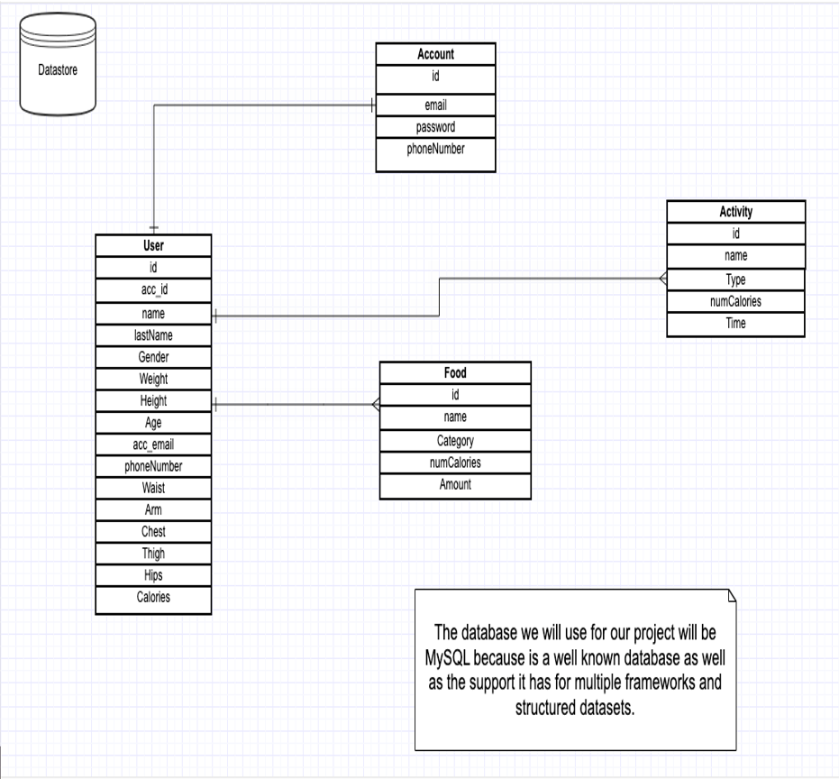
MySQL Database:
We have decided that we will use MySQL database server to store all data necessary for our application to function properly. MySQL offers great advantages for building relational databases and is a good fit since our application relies in multi-row transactions. Also, because is open-source, fast and reliable.
As we can see in our database schema, our database will store Account data, User data, User’s activity data and user’s food consumption data. This data will be helpful for multiple calculations like BMR, the amount of calories consumed at any given point, and much more!

